Slide 1

Support Vector Machine Data Classification using Simplified Sequential Minimal Optimization algorithm
Course: Software Engineering
Instructor: Mr. Damir Dobric Student: Thanh Tu Pham
Notes:
Good morning, Professor Trick and everyone. Today, I am going to introduce to you about Service Layer Core Protocol.

Slide 2
Agenda
Support Vector Machine overview
Architecture
Implementation
Q&A
Notes:
In my presentation, I will follow this agenda. Firstly, the brief definition and the goal of Service Layer is shown. In the next part, the architectural of Service Layer is explained in details.
And then principles and functions are mentioned. Finally is the reference.

Slide 3
Support Vector Machine Overview
Supervised classification

Slide 4
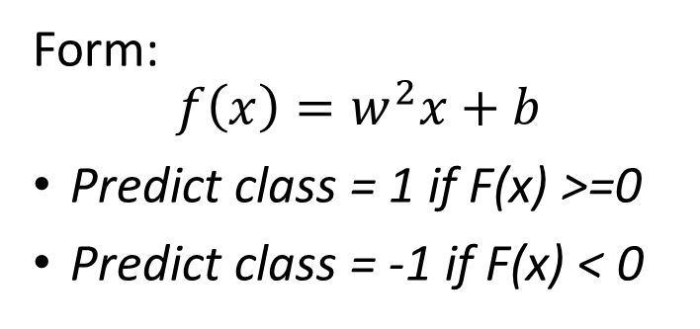
Linear SVM Mathematically
x⁺
M=Margin Width
“Predict Class = +1” zone
X⁻
wx+b=1
“Predict Class = -1” zone
wx+b=0
wx+b=-1
Form:
$$f\left(x\right)=w^{2}x+b$$
Predict class = 1 if F(x) >=0
Predict class = -1 if F(x) < 0

Slide 5
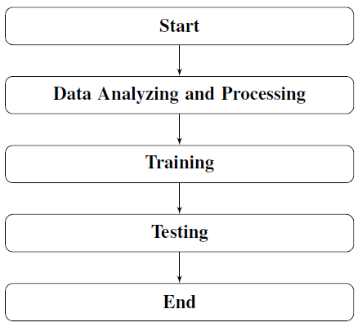
Architecture
The main architecture of the program

Slide 6
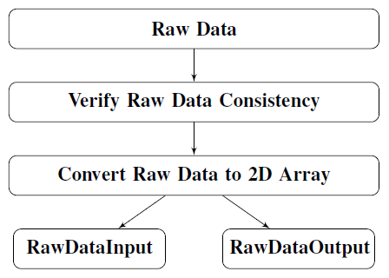
Data Analyzing and Processing
The flowchart of data analyzing and processing step

Slide 7
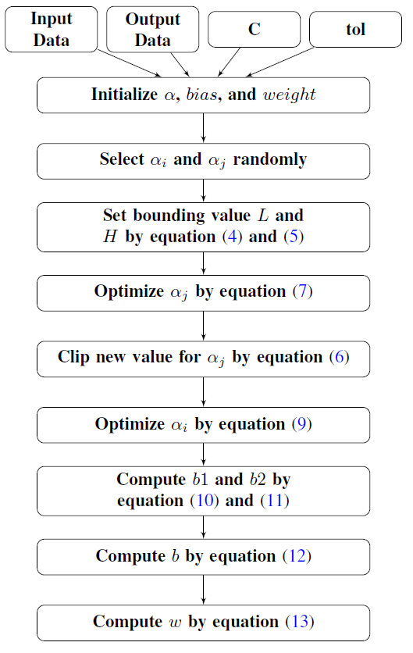
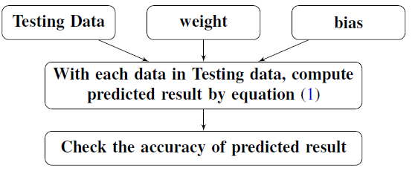
The flowchart of testing step
The flowchart of Training step

Slide 8
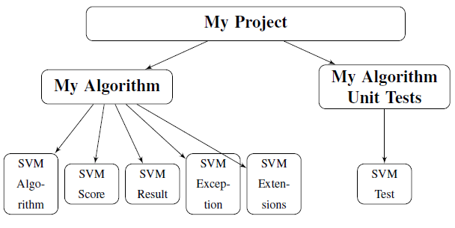
Implementation

Slide 9
Testing Result
Number of Data | Name | Number of samples | Number of features | Result (Accuracy in %)
1 | Iris flower data set | 100 | 4 | 100%
2 | Breast Cancer data set | 500 | 3 | 100%
3 | Ionosphere data set | 351 | 34 | ~93%

Slide 10
Question and Answering!

